Slide 1
Overview
General Principles of Pipelining
Goal
Difficulties
Creating a Pipelined Y86 Processor
Rearranging SEQ
Inserting pipeline registers
Problems with data and control hazards

Slide 2
SEQ Stages
newPC
PC
valE
,
valM
Write back
valM
Fetch
Read instruction from instruction memory
Decode
Read program registers
Execute
Compute value or address
Memory
Read or write data
Write Back
Write program registers
PC
Update program counter
Data
Memory
Data
memory
memory
Addr
, Data
valE
CC
CC
ALU
Execute
Cnd
ALU
aluA
,
aluB
valA
,
valB
Decode
srcA
,
srcB
A
A
B
dstA
,
dstB
B
M
Register
M
Register
Register
Register
file
file
file
file
E
E
icode
rA
,
ifun
valP
,
rB
valC
Instruction
PC
Instruction
PC
Fetch
memory
increment
memory
increment
PC

Slide 3


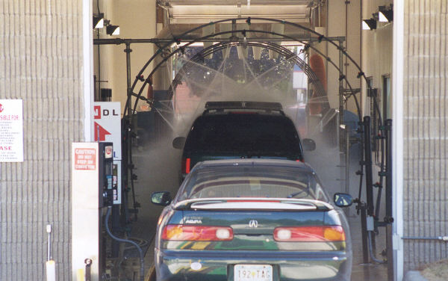
Real-World Pipelines: Car Washes
Sequential
Parallel
Pipelined
Idea
Divide process into independent stages
Move objects through stages in sequence
At any given times, multiple objects being processed

Slide 4
Computational Example
300 ps
20 ps
Combinational
logic
R
e
g
Delay = 320 ps
Throughput = 3.12 GIPS
Clock
System
Computation requires total of 300 picoseconds
Additional 20 picoseconds to save result in register
Must have clock cycle of at least 320 ps

Slide 5
3-Way Pipelined Version
100 ps
20 ps
100 ps
20 ps
100 ps
20 ps
Comb.
logic
A
R
e
g
Comb.
logic
B
R
e
g
Comb.
logic
C
R
e
g
Delay = 360 ps
Throughput = 8.33 GIPS
Clock
System
Divide combinational logic into 3 blocks of 100 ps each
Can begin new operation as soon as previous one passes through stage A.
Begin new operation every 120 ps
Overall latency increases
360 ps from start to finish

Slide 6
Pipeline Diagrams
Unpipelined
Cannot start new operation until previous one completes
3-Way Pipelined
Up to 3 operations in process simultaneously
OP1
OP2
OP3
Time
OP1
A
B
C
OP2
A
B
C
OP3
A
B
C
Time

Slide 7
Limitations: Nonuniform Delays
50 ps
20 ps
150 ps
20 ps
100 ps
20 ps
Comb.
logic
A
R
e
g
Comb.
logic
B
R
e
g
Comb.
logic
C
R
e
g
Delay = 510 ps
Throughput = 5.88 GIPS
Clock
OP1
A
B
C
OP2
A
B
C
OP3
A
B
C
Time
Throughput limited by slowest stage
Other stages sit idle for much of the time
Challenging to partition system into balanced stages

Slide 8
Limitations: Register Overhead
50 ps
20 ps
50 ps
20 ps
50 ps
20 ps
50 ps
20 ps
50 ps
20 ps
50 ps
20 ps
Comb.
logic
R
e
g
Comb.
logic
R
e
g
Comb.
logic
R
e
g
Comb.
logic
R
e
g
Comb.
logic
R
e
g
Comb.
logic
R
e
g
Clock
Delay = 420 ps, Throughput = 14.29 GIPS
As try to deepen pipeline, overhead of loading registers becomes more significant
Percentage of clock cycle spent loading register:
1-stage pipeline: 6.25%
3-stage pipeline: 16.67%
6-stage pipeline: 28.57%
High speeds of modern processor designs obtained through very deep pipelining

Slide 9
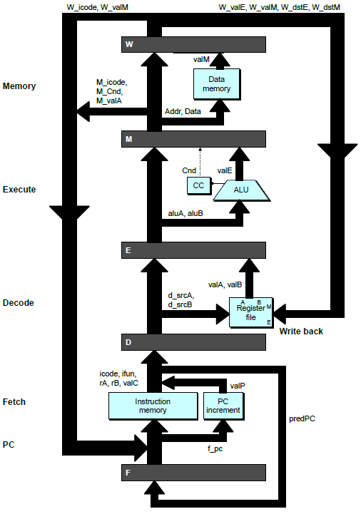
Adding Pipeline Registers
PC
newPC
valE
,
valM
Write back
valM
Data
Memory
Data
memory
memory
Addr
, Data
valE
CC
CC
ALU
Execute
Cnd
ALU
aluA
,
aluB
valA
,
valB
Decode
srcA
,
srcB
A
A
B
dstA
,
dstB
B
M
Register
M
Register
Register
Register
file
file
file
file
E
E
icode
,
ifun
valP
rA
,
rB
valC
Instruction
PC
Instruction
PC
Fetch
memory
increment
memory
increment
PC

Slide 10
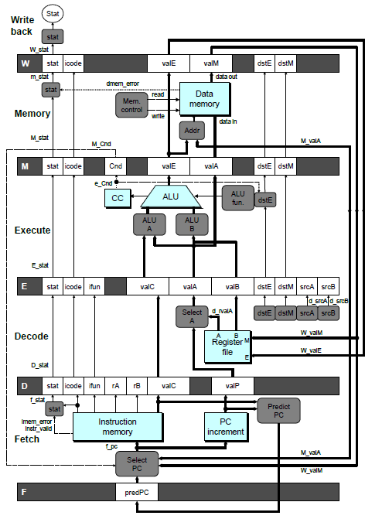
PIPE- Hardware
Pipeline registers hold intermediate values from instruction execution
Forward (Upward) Paths
Values passed from one stage to next
Cannot jump past stages
e.g., valC passes through decode

Slide 11
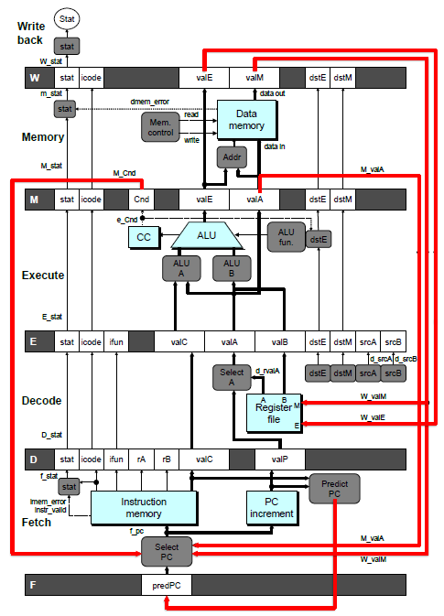
Feedback Paths
Predicted PC
Guess value of next PC
Branch information
Jump taken/not-taken
Fall-through or target address
Return point
Read from memory
Register updates
To register file write ports

Slide 12
Data Dependencies
Combinational
logic
R
e
g
Clock
OP1
OP2
OP3
Time
System
Each operation depends on result from preceding one

Slide 13
Data Dependencies in Processors
1 irmovl $50, %eax
2 addl %eax , %ebx
3 mrmovl 100( %ebx ), %edx
Result from one instruction used as operand for another
Read-after-write (RAW) dependency
Very common in actual programs
Must make sure our pipeline handles these properly
Get correct results
Minimize performance impact

Slide 14
Data Hazards
Comb.
logic
A
R
e
g
Comb.
logic
B
R
e
g
Comb.
logic
C
R
e
g
Clock
OP1
A
B
C
OP2
A
B
C
OP3
A
B
C
OP4
A
B
C
Time
Result does not feed back around in time for next operation
Pipelining has changed behavior of system

Slide 15
Data Dependencies: No Nop
# demo-h0.ys
1
2
3
4
5
6
7
8
0x000:
irmovl
$10,%
edx
F
D
E
M
W
0x006:
irmovl
$3,%
eax
F
D
E
M
W
0x00c:
addl
%
edx
,%
eax
F
D
E
M
W
0x00e: halt
F
D
E
M
W
Cycle 4
M
M_
valE
= 10
M_
dstE
=
%
edx
E
e_
valE
f
0 + 3 = 3
E_
dstE
=
%
eax
D
D
Error
f
valA
f
valA
R[
R[
]
]
=
=
0
%
0
%
edx
edx
f
valB
f
valB
R[
R[
]
]
=
=
0
%
0
%
eax
eax

Slide 16
Data Dependencies: 1 Nop
# demo-h1.ys
1
2
3
4
5
6
7
8
9
0x000:
irmovl
$10,%
edx
F
D
E
M
W
0x006:
irmovl
$3,%
eax
F
D
E
M
W
F
F
D
D
E
E
M
M
W
0x00c:
nop
W
F
F
D
D
E
E
M
M
W
0x00d:
addl
%
edx
,%
eax
W
F
F
D
D
E
E
M
M
W
0x00f: halt
W
Cycle 5
W
W
f
R[
f
R[
]
]
10
%
10
%
edx
edx
M
M_
valE
= 3
M_
dstE
=
%
eax
•
•
•
D
D
Error
f
valA
f
valA
R[
R[
]
]
=
=
0
%
0
%
edx
edx
f
valB
f
valB
R[
R[
]
]
=
=
0
%
0
%
eax
eax

Slide 17
Data Dependencies: 2 Nop’s
# demo-h2.ys
1
2
3
4
5
6
7
8
9
10
F
F
D
D
E
E
M
M
W
0x000:
irmovl
$10,%
edx
W
F
F
D
D
E
E
M
M
W
0x006:
irmovl
$3,%
eax
W
F
F
D
D
E
E
M
M
W
0x00c:
nop
W
F
F
D
D
E
E
M
M
W
0x00d:
nop
W
F
F
D
D
E
E
M
M
W
0x00e:
addl
%
edx
,%
eax
W
F
F
D
D
E
E
M
M
W
0x010: halt
W
Cycle 6
W
W
W
f
f
R[
f
R[
R[
]
]
]
3
3
%
3
%
%
eax
eax
eax
•
•
•
•
•
•
D
D
D
f
f
valA
f
valA
valA
R[
R[
R[
]
]
]
=
=
=
10
10
%
10
Error
%
%
edx
edx
edx
f
f
valB
f
valB
valB
R[
R[
R[
]
]
]
=
=
=
0
0
%
0
%
%
eax
eax
eax

Slide 18
Data Dependencies: 3 Nop’s
# demo-h3.ys
1
2
3
4
5
6
7
8
9
10
11
F
F
D
D
E
E
M
M
W
0x000:
irmovl
$10,%
edx
W
F
F
D
D
E
E
M
M
W
0x006:
irmovl
$3,%
eax
W
F
F
D
D
E
E
M
M
W
0x00c:
nop
W
F
F
D
D
E
E
M
M
W
0x00d:
nop
W
F
F
D
D
E
E
M
M
W
0x00e:
nop
W
F
F
D
D
E
E
M
M
W
0x00f:
addl
%
edx
,%
eax
W
F
F
D
D
E
E
M
M
W
0x011: halt
W
Cycle 6
W
W
f
R[
f
R[
]
]
3
%
3
%
eax
eax
Cycle 7
D
D
f
valA
f
valA
R[
R[
]
]
=
=
10
%
10
%
edx
edx
f
valB
f
valB
R[
R[
]
]
=
=
3
%
3
%
eax
eax

Slide 19
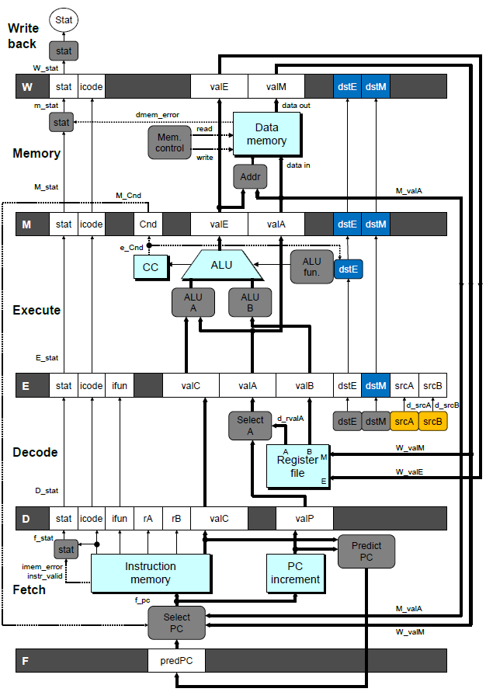
Stall Condition
Source Registers
srcA and srcB of current instruction in decode stage
Destination Registers
dstE and dstM fields
Instructions in execute, memory, and write-back stages
Special Case
Don’t stall for register ID 15 (0xF)
Indicates absence of register operand

Slide 20
Data Forwarding
Naïve Pipeline
Register isn’t written until completion of write-back stage
Source operands read from register file in decode stage
Needs to be in register file at start of stage
Observation
Value generated in execute or memory stage
Trick
Pass value directly from generating instruction to decode stage
Needs to be available at end of decode stage

Slide 21
Data Forwarding Example
Register %edx
Generated by ALU during previous cycle
Forward from memory as valA
Register %eax
Value just generated by ALU
Forward from execute as valB

Slide 22
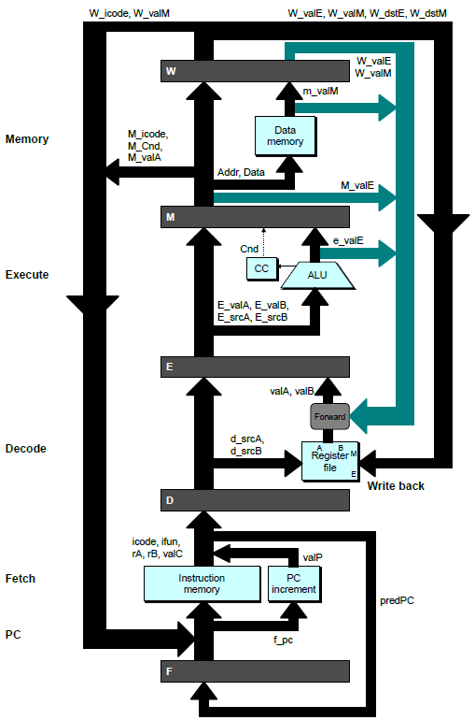
Bypass Paths
Decode Stage
Forwarding logic selects valA and valB
Normally from register file
Forwarding: get valA or valB from later pipeline stage
Forwarding Sources
Execute: valE
Memory: valE, valM
Write back: valE, valM

Slide 23
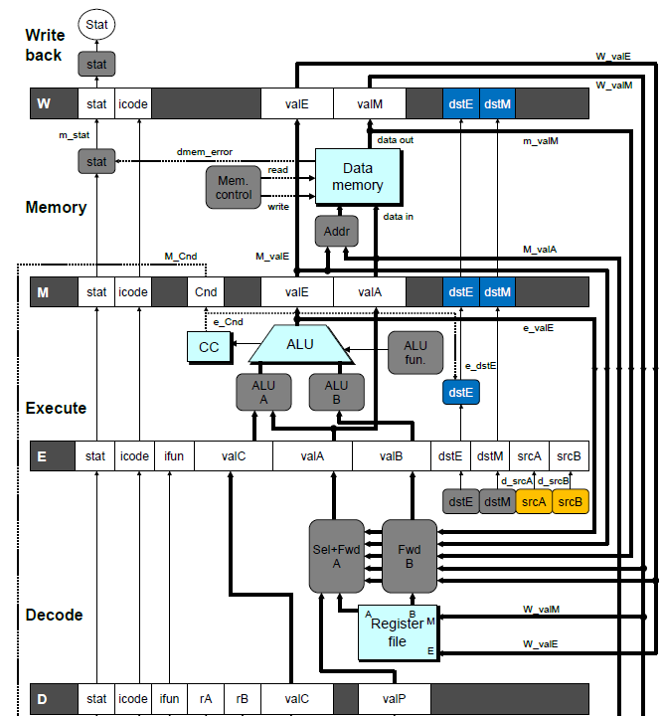
Implementing Forwarding
Add additional feedback paths from E, M, and W pipeline registers into decode stage
Create logic blocks to select from multiple sources for valA and valB in decode stage

Slide 24
Limitation of Forwarding
Load-use dependency
Value needed by end of decode stage in cycle 7
Value read from memory in memory stage of cycle 8

Slide 25
Avoiding Load/Use Hazard
Stall using instruction for one cycle
Can then pick up loaded value by forwarding from memory stage

Slide 26
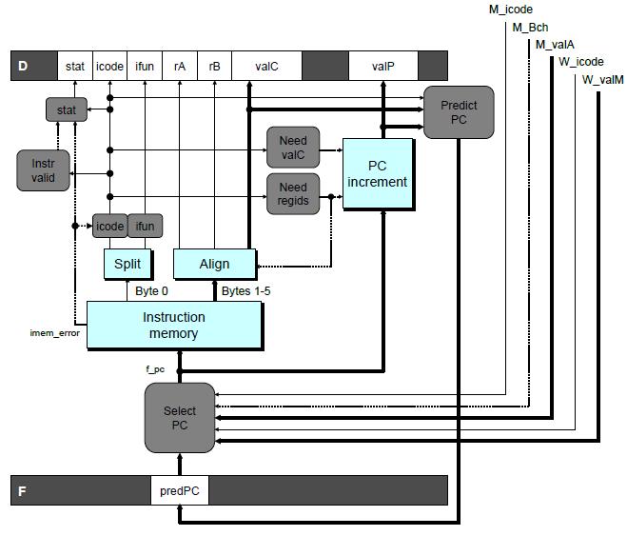
Predicting the PC
Start fetch of new instruction after current one has completed fetch stage
Not enough time to reliably determine next instruction
Guess which instruction will follow
Recover if prediction was incorrect

Slide 27
Our Prediction Strategy
Instructions that Don’t Transfer Control
Predict next PC to be valP
Always reliable
Call and Unconditional Jumps
Predict next PC to be valC (destination)
Always reliable
Conditional Jumps
Predict next PC to be valC (destination)
Only correct if branch is taken
Typically right ~60% of time
Return Instruction
Don’t try to predict

Slide 28
Recovering from PC Misprediction
Mispredicted Jump
Will see branch condition flag once instruction reaches memory stage
Can get fall-through PC from valA (value M_valA)
Return Instruction
Will get return PC when ret reaches write-back stage (W_valM)

Slide 29
Branch Misprediction Example
demo-j.ys
0x000: xorl %eax,%eax
0x002: jne t # Not taken
0x007: irmovl $1, %eax # Fall through
0x00d: nop
0x00e: nop
0x00f: nop
0x010: halt
0x011: t: irmovl $2, %edx # Target (Should not execute)
0x017: irmovl $3, %ecx # Should not execute
0x01d: irmovl $4, %edx # Should not execute
Should only execute first 7 instructions

Slide 30
Handling Misprediction
Predict branch as taken
Fetch 2 instructions at target
Cancel when mispredicted
Detect branch not-taken in execute stage
On following cycle, replace instructions in execute and decode by bubbles
No side effects have occurred yet

Slide 31
Return Example
demo-retb.ys
0x000: irmovl Stack,%esp # Initialize stack pointer
0x006: call p # Procedure call
0x00b: irmovl $5,%esi # Return point
0x011: halt
0x020: .pos 0x20
0x020: p: irmovl $-1,%edi # procedure
0x026: ret
0x027: irmovl $1,%eax # Should not be executed
0x02d: irmovl $2,%ecx # Should not be executed
0x033: irmovl $3,%edx # Should not be executed
0x039: irmovl $4,%ebx # Should not be executed
0x100: .pos 0x100
0x100: Stack: # Stack: Stack pointer
Previously executed three additional instructions

Slide 32
Correct Return Example
# demo
-
retb
0x026: ret
F
D
E
M
W
bubble
F
D
E
M
W
bubble
F
D
E
M
W
bubble
F
D
E
M
W
F
F
D
D
E
E
M
M
W
0x00b:
irmovl
$5,%
esi
# Return
W
As ret passes through pipeline, stall at fetch stage
While in decode, execute, and memory stage
Inject bubble into decode stage
Release stall when reach write-back stage
W
W
valM
valM
=
=
0x0b
0x0b
•
•
•
F
F
f
valC
f
valC
5
5
f
rB
f
rB
%
%
esi
esi

Slide 33
Pipeline Summary
Data Hazards
Three-cycle stall with no forwarding
Must wait for dependencies to finish writeback before next instruction can read from registers in decode
Most handled by forwarding
No performance penalty
Load/use hazard requires one cycle stall
Can forward from memory after one cycle
Control Hazards
Cancel instructions when detect mispredicted branch
Two clock cycles wasted
Stall fetch stage while ret passes through pipeline
Three clock cycles wasted

Slide 34
Overview
Wrap-Up of PIPE Design
Exceptional conditions
Performance analysis
Modern High-Performance Processors
Out-of-order execution

Slide 35
Exceptions
Conditions under which processor cannot continue normal operation
Causes
Halt instruction (Current)
Bad address for instruction or data (Previous)
Invalid instruction (Previous)
Typical Desired Action
Complete some instructions
Either current or previous (depends on exception type)
Discard others
Call exception handler
Like an unexpected procedure call

Slide 36
Exception Examples
Detect in Fetch Stage
jmp $-1 # Invalid jump target
.byte 0xFF # Invalid instruction code
halt # Halt instruction
Detect in Memory Stage
irmovl $100,%eax
rmmovl %eax,0x10000(%eax) # invalid address

Slide 37
Exceptions in Pipeline Processor
# demo-exc1.ys
irmovl $100,%eax
rmmovl %eax,0x10000(%eax) # Invalid address
nop
.byte 0xFF # Invalid instruction code
1
2
3
4
5
0x000: irmovl $100,%eax
F
D
E
M
W
Exception detected
0x006: rmmovl %eax,0x1000(%eax)
F
D
E
M
0x00c: nop
F
D
E
0x00d: .byte 0xFF
F
D
Exception detected
Desired Behavior
rmmovl should cause exception
Following instructions should have no effect on processor state

Slide 38
Maintaining Exception Ordering
W
stat
icode
valE
valM
dstE
dstM
M
stat
icode
Cnd
valE
valA
dstE
dstM
E
stat
icode
ifun
valC
valA
valB
dstE
dstM
srcA
srcB
D
stat
icode
ifun
rA
rB
valC
valP
F
predPC
Add status field to pipeline registers
Fetch stage sets to either “AOK,” “ADR” (when bad fetch address), “HLT” (halt instruction) or “INS” (illegal instruction)
Decode & execute pass values through
Memory either passes through or sets to “ADR”
Exception triggered only when instruction hits write back

Slide 39
Performance Metrics
Clock rate
Measured in Gigahertz
Function of stage partitioning and circuit design
Keep amount of work per stage small
Rate at which instructions executed
CPI: cycles per instruction
On average, how many clock cycles does each instruction require?
Function of pipeline design and benchmark programs
E.g., how frequently are branches mispredicted?

Slide 40
CPI for PIPE
CPI ≈ 1.0
Fetch instruction each clock cycle
Effectively process new instruction almost every cycle
Although each individual instruction has latency of 5 cycles
CPI > 1.0
Sometimes must stall or cancel branches
Computing CPI
C clock cycles
I instructions executed to completion
B bubbles injected (C = I + B)
CPI = C/I = (I+B)/I = 1.0 + B/I
Factor B/I represents average penalty due to bubbles

Slide 41
CPI for PIPE (Cont.)
B/I = LP + MP + RP
LP: Penalty due to load/use hazard stalling
Fraction of instructions that are loads 0.25
Fraction of load instructions requiring stall 0.20
Number of bubbles injected each time 1
⇒ LP = 0.25 * 0.20 * 1 = 0.05
MP: Penalty due to mispredicted branches
Fraction of instructions that are cond. jumps 0.20
Fraction of cond. jumps mispredicted 0.40
Number of bubbles injected each time 2
⇒ MP = 0.20 * 0.40 * 2 = 0.16
RP: Penalty due to ret instructions
Fraction of instructions that are returns 0.02
Number of bubbles injected each time 3
⇒ RP = 0.02 * 3 = 0.06
Net effect of penalties 0.05 + 0.16 + 0.06 = 0.27
⇒ CPI = 1.27 (Not bad!)
Typical Values

Slide 42
Modern CPU Design

Slide 43
Instruction Control
Grabs Instruction Bytes From Memory
Based on Current PC + Predicted Targets for Predicted Branches
Hardware dynamically guesses whether branches taken/not taken and (possibly) branch target
Translates Instructions Into Operations
Primitive steps required to perform instruction
Typical instruction requires 1–3 operations
Converts Register References Into Tags
Abstract identifier linking destination of one operation with sources of later operations

Slide 44
Execution Unit
Register
Prediction
Operations
Updates
OK?
Integer/
General
FP
FP
Load
Store
Functional
Branch
Integer
Add
Mult
/Div
Units
Operation Results
Addr
.
Addr
.
Data
Data
Data
Cache
Execution
Execution
Multiple functional units
Each can operate independently
Operations performed as soon as operands available
Not necessarily in program order
Within limits of functional units
Control logic
Ensures behavior equivalent to sequential program execution

Slide 45
CPU Capabilities of Intel iCore7
Multiple Instructions Can Execute in Parallel
1 load
1 store
1 FP multiplication or division
1 FP addition
> 1 integer operation
Some Instructions Take > 1 Cycle, but Can be Pipelined
Instruction Latency Cycles/Issue
Load / Store 3 1
Integer Multiply 3 1
Integer Divide 11—21 5—13
Double/Single FP Multiply 4 1
Double/Single FP Add 3 1
Double/Single FP Divide 10—15 6—11

Slide 46
High-Performance Branch Prediction
Critical to Performance
Typically 11–15 cycle penalty for misprediction
Branch Target Buffer
512 entries
4 bits of history
Adaptive algorithm
Can recognize repeated patterns, e.g., alternating taken–not taken

Slide 47
Example Branch Prediction
Branch History
Encode information about prior history of branch instructions
Predict whether or not branch will be taken
State Machine
Each time branch taken, transition to right
When not taken, transition to left
Predict branch taken when in state Yes! or Yes?
NT
NT
NT
T
Yes!
Yes?
No?
No!
NT
T
T
T

Slide 48
Processor Summary
Design Technique
Create uniform framework for all instructions
Want to share hardware among instructions
Connect standard logic blocks with bits of control logic
Operation
State held in memories and clocked registers
Computation done by combinational logic
Clocking of registers/memories sufficient to control overall behavior
Enhancing Performance
Pipelining increases throughput and improves resource utilization
Must make sure to maintain ISA behavior

Slide 49

Xbox One
AMD “Jaguar” Accelerated Processing Unit (APU)
2 quad-core x86-64 processors at 1.75 GHz
Integrated CPU/GPU
768 GPU cores at 853 MHz
Direct X 11.1
8 GB of 2133 MHz DDR3 RAM
3 GB for OS, 5 GB for apps
500 GB hard drive

Slide 50

Playstation 4
AMD “Jaguar” Accelerated Processing Unit (APU)
2 quad-core x86-64 processors at 1.6 GHz
Integrated CPU/GPU
1152 GPU cores at 853 MHz
Direct X 11.2
8 GB of 5500 MHz GDDR5 RAM
3.5 GB for OS, 4.5 GB for apps
500 GB hard drive

